Slide 1
Cantor Fitzgerald Income Trust, Inc.
++
A Publicly Registered, Non-Traded Real Estate Income Trust¹
This is neither an offer to sell nor a solicitation of an offer to buy the securities described herein. An offering is made only by prospectus. You should read the prospectus in order to understand fully all of the implications and risks of this offering. No offering is made except by a prospectus filed with the Department of Law of the State of New York. Neither the Attorney General of the State of New York nor any other state or federal securities regulator has passed on or endorsed the merits of this offering or these securities or confirmed the adequacy of the prospectus. Any representation to the contrary is unlawful. All information contained in this material is qualified in its entirety by the terms of the current prospectus.
¹We elected to be taxed as a Real Estate Income Trust (“REIT”) beginning in the taxable year ending December 31, 2017. Our failure to qualify as a REIT would result in higher taxes, may adversely affect our operations, would reduce the amount of income available for distribution and would limit our ability to make distributions to our shareholders.
We may change our investment objectives, policies and strategy at any time without shareholder consent. There is no assurance that we will be able to invest in our targeted investments. Diversification does not eliminate risk and does not assure better performance.
There is no guarantee of distributions. Distributions may be paid from sources other than cash flow from operations, including offering proceeds, which may reduce an investor’s overall return.
Not for use in New Jersey or Ohio
cfincometrust.com

Slide 2
An Important Note Before We Begin
The performance of Cantor Fitzgerald, L.P. is not indicative of performance of Cantor Fitzgerald Income Trust, Inc. (“Cantor Fitzgerald Income Trust“ or “CF Income Trust”). Cantor Fitzgerald Income Trust and Cantor Fitzgerald, L.P. are separate companies. An investor purchasing shares in Cantor Fitzgerald Income Trust’s public offering is making an investment in Cantor Fitzgerald Income Trust, not in Cantor Fitzgerald, L.P.
Cantor Fitzgerald, or Cantor, refers to Cantor Fitzgerald, L.P., its subsidiaries, including Cantor Fitzgerald & Co., and its affiliates including BGC Partners (NASDAQ: BGCP) and Newmark Knight Frank (NASDAQ:NMRK).
Our affiliation with Cantor may not lead to investment opportunities for us. Cantor Fitzgerald Income Trust may compete with other companies affiliated with Cantor for investment opportunities.
Cantor Fitzgerald Income Trust has not been rated by any rating agency.
This presentation contains forward-looking statements about our business, including, in particular, statements about our plans, strategies and objectives. You can generally identify forward-looking statements by our use of forward-looking terminology such as “may,” “will,” “expect,” “intend,” “anticipate,” “estimate,” “believe,” “continue” or other similar words. You should not rely on these forward-looking statements because the matters they describe are subject to known and unknown risks, uncertainties and other unpredictable factors, many of which are beyond our control. Our actual results, performance and achievements may be materially different from that expressed or implied by these forward-looking statements.
CF Income Trust was formerly known as Rodin Global Property Trust, Inc.
Current Publication Date: 1/19/2022

Slide 3
Risk Factors
We have a limited operating history and limited assets. This is a “blind pool” offering and we have not identified specific investments to acquire with the proceeds of this offering.
This is a “best efforts” offering and if we raise substantially less than the maximum offering, we may not be able to invest in a diverse portfolio of stabilized income-producing commercial real-estate, debt secured by commercial real estate and real estate-related assets.
The transaction price may not accurately represent the value of our assets at any given time and the actual value of your investment may be substantially less. The transaction price generally will be based on our most recently disclosed monthly net asset value (“NAV”) of each class of common stock (subject to material changes) and will not be based on any public trading market. In addition, the transaction price will not represent our enterprise value and may not accurately reflect the actual prices at which our assets could be liquidated on any given day, the value a third party would pay for all or substantially all of our shares, or the price at which our shares would trade on a national stock exchange. Further, our board of directors may amend our NAV procedures from time to time.
The amount and timing of distributions we may make is uncertain. Distributions have been and may continue to be paid from sources other than cash flow from operations, including, without limitation, from borrowings, the sale of assets, or offering proceeds. The use of these sources for distributions may decrease the amount of cash we have available for new investments, share repurchases and other corporate purposes, and could reduce your overall return.
There is no public trading market for our common stock and repurchase of shares by us will likely be the only way to dispose of your shares. We are not obligated to repurchase any shares under our share repurchase plan and may choose to repurchase only some, or even none, of the shares that have been requested to be repurchased. In addition, repurchases will be subject to available liquidity and other significant restrictions. Further, our board of directors may modify, suspend or terminate our share repurchase plan. As a result, our shares should be considered as having only limited liquidity and at times may be illiquid.
All of our executive officers, some of our directors and other key real estate professionals are also officers, directors, managers and key professionals of our advisor, our dealer manager or other entities affiliated with Cantor, which we refer to as the Cantor Companies. As a result, they face conflicts of interest, including significant conflicts created by our advisor’s compensation arrangements with us and other Cantor-advised programs and investors.
We may change our investment policies without stockholder notice or consent, which could result in investments that are different from those described in this prospectus.
If we fail to qualify as a REIT, it would adversely affect our operations and our ability to make distributions to our stockholders.
The current outbreak of the novel coronavirus, or COVID-19, or the future outbreak of any other highly infectious or contagious diseases, could adversely impact or cause disruption to our financial condition and results of operations. Further, the spread of the COVID-19 outbreak could cause severe disruptions in the U.S. and global economy, may further disrupt financial markets and could potentially create widespread business continuity issues.

Slide 4
Global Financial Services Firm with Fully-Integrated Real Estate Capabilities
Founded in 1945
12,000+
Employees
160 Offices in worldwide
Investment Grade
1 of 24 Primary Dealers
A global financial services firm with significant real estate, capital markets, research and investment expertise
More than 12,000 employees worldwide
Cantor Fitzgerald maintains more than 160 offices in 22 countries
Maintains an investment-grade credit rating by Standard & Poor’s and Fitch
One of 24 primary dealers of U.S. government securities
Cantor Fitzgerald refers to Cantor Fitzgerald, L.P., its subsidiaries, including Cantor Fitzgerald & Co., and its affiliates including BGC Partners (NASDAQ: BGCP) and Newmark Knight Frank (NASDAQ:NMRK).
The performance of Cantor Fitzgerald, L.P. is not indicative of the performance of Cantor Fitzgerald Income Trust. Cantor Fitzgerald Income Trust and Cantor Fitzgerald, L.P. are separate companies. An investor purchasing shares in Cantor Fitzgerald Income Trust’s public offering is making an investment in Cantor Fitzgerald Income Trust, not in Cantor Fitzgerald, L.P. Past performance does not guarantee future results.
The securities of Cantor Fitzgerald Income Trust have not been rated by any rating agency.

Slide 5
Cantor Fitzgerald in Real Estate
More than $150 Billion in Real Estate-Related Transactions Since 2019
Real Estate Capabilities
Investment sales
Leasing
Valuation
Property management
Capital raising
Investment management
Multifamily agency lending
Fannie Mae, Freddie Mac and FHA/Ginnie Mae
$68 billion servicing portfolio; more than 3,800 loans; 48 states
Fixed and floating rate commercial real estate loans
Stable and transitional properties
Securitizations
Debt placement
Consulting
Facilities management
Cantor Fitzgerald refers to Cantor Fitzgerald, L.P., its subsidiaries, including Cantor Fitzgerald & Co., and its affiliates including BGC Partners (NASDAQ: BGCP) and Newmark Knight Frank (NASDAQ:NMRK).
The performance of Cantor Fitzgerald, L.P. is not indicative of the performance of Cantor Fitzgerald Income Trust. Cantor Fitzgerald Income Trust and Cantor Fitzgerald, L.P. are separate companies. An investor purchasing shares in Cantor Fitzgerald Income Trust’s public offering is making an investment in Cantor Fitzgerald Income Trust, not in Cantor Fitzgerald, L.P. Past performance does not guarantee future results.

Slide 6
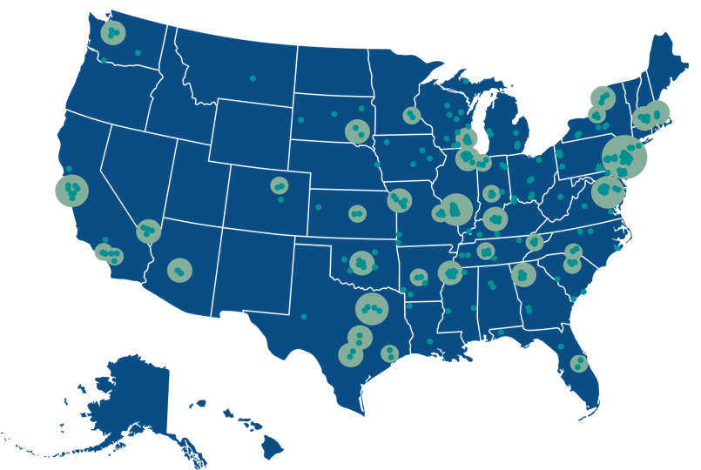
Cantor Fitzgerald’s National Real Estate Reach
Real-time access to vast commercial real estate data helps put us at the nexus of every phase of a transaction — from buying and selling to financing some of the world’s leading properties.
2020 Year-in-Review
46 States
real estate-related transactions¹ in
$48.2 Billion
in real estate brokerage
$24.1
Billion
of real estate financed
Over 750 Million
square feet managed
¹Includes originated debt and non-originated debt placement transactions.
The performance of Cantor Fitzgerald, L.P. is not indicative of the performance of Cantor Fitzgerald Income Trust. Cantor Fitzgerald Income Trust and Cantor Fitzgerald, L.P. are separate companies. An investor purchasing shares in Cantor Fitzgerald Income Trust’s public offering is making an investment in Cantor Fitzgerald Income Trust, not in Cantor Fitzgerald, L.P. Past performance does not guarantee future results.

Slide 7
IRC Section 1031
IRC SECTION 1031 STATES
1031 EXCHANGE RULES
“
7
No gain or loss shall be recognized on the exchange of real property held for productive use in a trade or business or for investment if such real property is exchanged solely for real property of LIKE-KIND* which is to be held either for productive use in a trade or business or for investment.
PURCHASE
VALUE
SOLD
VALUE
>
INVESTED EQUITY
_
EQUITY AMOUNT
FROM SALE
“
DEBT ON REPLACEMENT PROPERTY
DEBT ON RELINQUISHED PROPERTY
*Like-kind is a property similar in nature or character, regardless of differences in grade, property type, or quality.
Invested equity must be equal to or greater than the equity received from sale, and the total purchase of the replacement property must be equal to or greater than value of the property sold.
Day
Day
Day
1031 EXCHANGE TIMELINE
Sale of relinquished property
Identification period starts
Identification period ends
Last day to purchase
replacement property

Slide 8
Delaware Statutory Trusts (“DSTs”)
A business trust that can be used for real estate ownership of higher-quality, professionally managed commercial properties; provides a passive, turn-key solution for transacting a 1031 exchange.
HOLDINGS OF IRS REVENUE RULING 2004-86
“(1) The Delaware Statutory Trust is an investment trust, under § 301.7701-4(c), that will be classified as a trust for federal tax purposes.
(2) A taxpayer may exchange real property for an interest in the Delaware Statutory Trust without recognition of gain or loss under Section 1031, if the other requirements of Section 1031 are satisfied.”
Investors in a DST are not direct owners of the real estate, but instead own an undivided interest in the assets held by the trust.
The Trust holds title to the property for the benefit of many investors.
DSTs are recognized by the IRS (Revenue Ruling 2004-86) as qualified replacement property for real property.
Property types may include Triple-Net, multifamily, industrial, office, self storage and many others.
There is no guarantee of success. Investors could incur a loss of all or a portion of their investment.

Slide 9
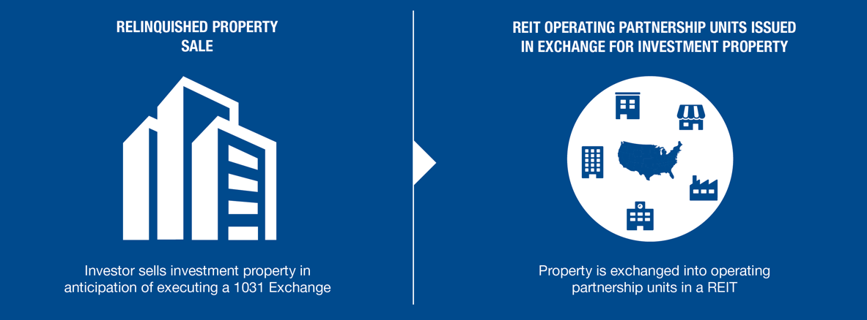
IRC Section 721 and the Two-Step Transaction
HOW IT WORKS
Section 721 of the Internal Revenue Code allows real estate owners to convert, tax-deferred, their physical property into interests in the operating partnership of a real estate investment trust (“REIT”) using an Umbrella Partnership Real Estate Investment Trust (“UPREIT”) structure. The 721 exchange is an alternative solution to a traditional 1031 exchange. A 721 exchange tends to appeal to a property owner seeking the potential benefits of a larger real estate portfolio including diversification, professional management, economies of scale, access to capital, increased liquidity, and additional estate planning benefits, all while deferring the recognition of a capital gain on their original property.
THE TWO-STEP TRANSACTION USING A DST
A common way that a 721 exchange is accomplished is when investors acquire interests in a DST through a 1031 exchange and then subsequently exchanges such interests for interests in the operating partnership of an UPREIT via a 721 exchange.

Slide 10
The QOZ Program
The QOZ Program was created by the federal government as part of the Tax Cuts and Jobs Act of 2017.
The QOZ Program is intended to encourage investment in lower-income communities across the U.S., principally by providing certain tax incentives in return for committing long-term capital to these communities through investment vehicles called QOFs.
WHAT ARE QUALIFIED OPPORTUNITY ZONES?
A QOZ is a designated census tract in the United States selected by a state governor and certified by the U.S. Department of Treasury for inclusion in the QOZ Program.
Each state governor was permitted to nominate up to 25% of the state’s qualifying census tracts for inclusion in the QOZ Program.
In order to qualify for inclusion, a census tract must satisfy one of the following low-income community (“LIC”) tests based on the 2010 census:
have a poverty rate of at least 20%,
if the LIC is in a metropolitan area, have a median household income not exceeding 80% of the metropolitan median household income (or the statewide median household income, whichever is greater) or
if the LIC is not located in a metropolitan area, have a median household income not exceeding 80%of the statewide median household income.
WHAT ARE QOFs?
A QOF is an investment vehicle that holds at least 90% of its assets in “qualified opportunity zone property’. QOFs can make investments in a wide variety of real estate and new or existing businesses. QOFs can hold single or multiple assets. Qualified opportunity zone property includes interests held by the QOF in a “Qualified Opportunity Zone Business’.

Slide 11
Potential Tax Benefits
Substantial potential tax benefits may be available to investors who realize short-term or long-term capital gains from the sale of an investment and reinvest those gains into a QOF within 180 days. Gains from stocks, bonds, real estate, companies, among other assets, are eligible.
DEFERRAL
If a taxpayer invests the capital gain from the sale of any property into a QOF within 180 days of recognizing the gain, taxes on such proceeds may be deferred until the earlier of December 31, 2026¹ or the disposition of the QOF interest.
ELIMINATION
Investors who hold their investment for at least ten years receive a step-up in basis which means they pay no tax on the appreciation of their QOF investment upon disposition or through 2047, whichever occurs first, regardless of the size of the potential profit.² In addition, the step-up in basis eliminates any depreciation recapture tax that would otherwise be owed upon sale.
¹ A 10% step-up in basis was available for investments made prior to December 31, 2021 and an additional 5% step-up in basis was available for investments made prior to December 31, 2019.
² Assumes that the investor is a resident of a state that conforms with the QOZ Program or a no state income tax state, otherwise the investor will owe tax on any realized gain in investor’s state.

Slide 12
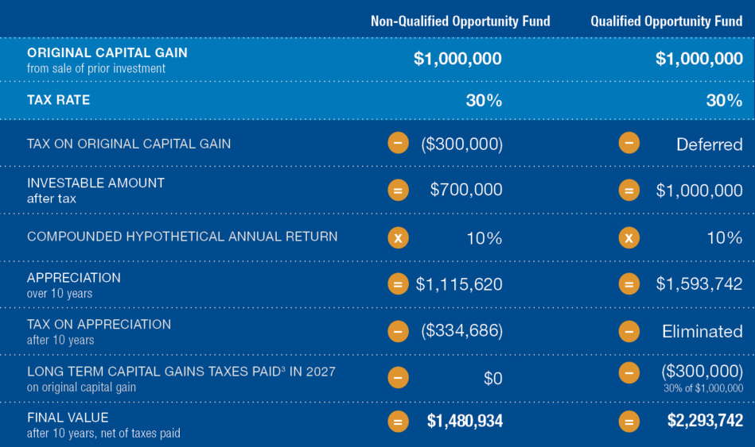
An Opportunity for Increased After-Tax Return Potential
SCENARIO: HYPOTHETICAL AFTER-TAX VALUE^{1,2,3}
Two investors each sell an asset that generates a $1,000,000 long-term gain. Investor A pays capital gains taxes and invests the remaining capital in a product that generates a 10% compounded annual return over ten years and then liquidates the investment. Investor B invests the gain in a Qualified Opportunity Fund, which generates the same return over the same time period. Both investors are residents of a state that conforms with the QOZ Program and are subject to the top marginal U.S. federal income tax rate of 20% on long-term capital gains for individuals, the net investment income tax of 3.8% and a state tax of 6.2%, for a total tax liability of 30%.
¹ This illustration assumes the investor is subject to the top marginal U.S. federal income tax rate of 20% on long-term capital gains for individuals, the net investment income tax of 3.8% and a state tax of 6.2% for a total tax liability of 30%. No brokerage or investment advisory fees are accounted for with respect to the non-QOF example above and no distributions made on the Class C common stock, no fees due to our Manager and its affiliates and no sales commissions, deal manager fees and non-accountable diligence and marketing allowances due to our Managing Broker-Dealer and its affiliates are accounted for with respect to the QOF example.
² This assumes that the QOF investor is a resident of a state that conforms with the QOZ Program.
³ Assumes that the investor has no capital losses to reduce such capital gain and refers to the inclusion of the original, invested capital gains in such investor’s taxable income on December 31, 2026.

Slide 13
CANTOR FITZGERALD INCOME TRUST, INC.
(“CFIT”)
^{EXECUTIVE SUMMARY}

Slide 14
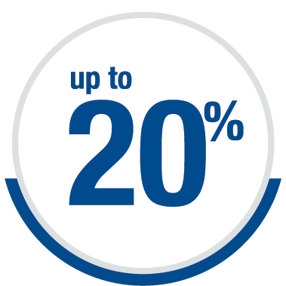
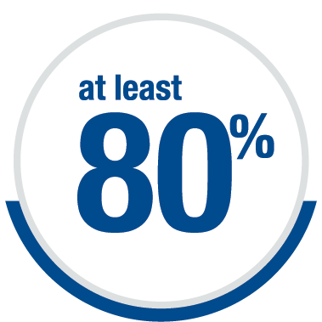
CF Income Trust Executive Summary
Institutional Real Estate Investment Opportunities for Income-Focused Investors¹
Investment Objectives
Capital Preservation | Income Generation | Appreciation
STRATEGY²
CF Income Trust intends to invest in a diversified portfolio focusing primarily on:
Real Estate: Stabilized, income-producing commercial real estate (“CRE”) properties, primarily located in the U.S.
• Office • Industrial • Multifamily • Retail • Other
Real Estate Debt: Mortgage and mezzanine capital secured by stabilized, income-producing CRE properties which may provide additional sources of income and diversification.
• First Mortgage • Subordinated Mortgage • Mezzanine Capital
CF Income Trust may selectively acquire and hold real estate-related securities to support the overall investment objectives of the company.
STRUCTURE²
Type: Non-listed, monthly-valued perpetual Real Estate Income Trust (“REIT”)
Distributions: Monthly³
subject to board declaration
Tax Reporting: Single Form 1099-DIV
Liquidity: Monthly⁴
Leverage: Modest
¹ Institutional investors may invest in real estate on substantially different terms and conditions than retail investors.
² See Offering Details on slide 35.
³ There is no guarantee of distributions. Distributions have and may continue to be paid from other sources other than cash flow from operations, including offering proceeds, which reduce investor’s overall return. Distributions paid with respect to Class D Shares, T Shares and Class S Shares will be reduced by the ongoing distribution fee payable with respect to such classes of shares.
⁴ Repurchases are limited to 5% per quarter and 2% per month of the combined NAV of all classes of shares as of the last calendar day of the previous calendar quarter or month, respectively; the program may be modified, suspended or terminated at any time upon ten days prior written notice to stockholders.

Slide 15
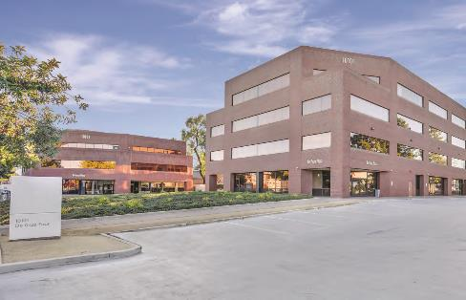
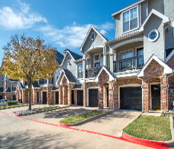
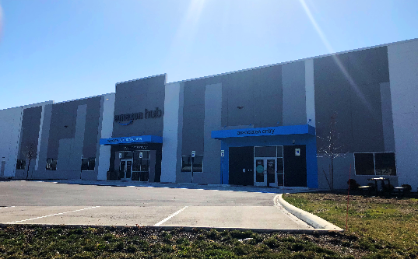
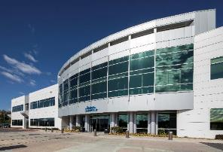
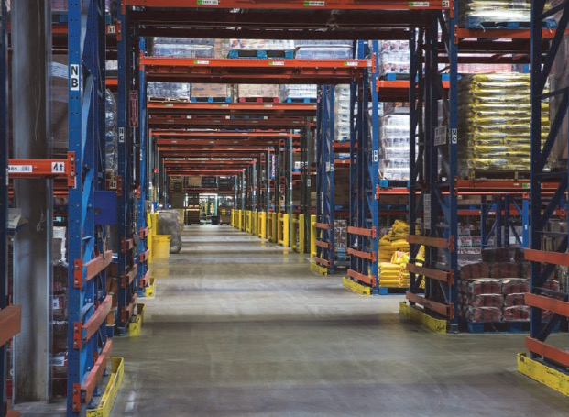
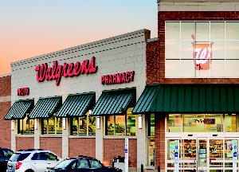
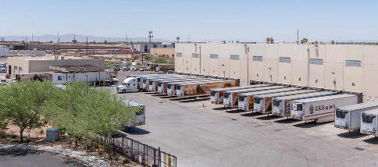
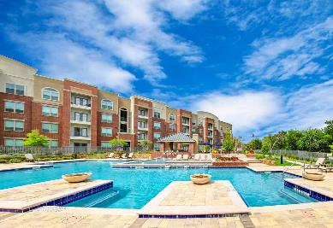
Select CF Income Trust Investments
De Anza Plaza Apple Inc.
Cupertino, CA
Station at MacArthur Multifamily
Irving, TX
Amazon Last Mile Distribution Facility
Cleveland, OH
Boston Scientific Corporation
Santa Clarita, CA
Albertsons Dry Bulk/Cold Storage Distribution Facilities
Various, U.S.
Daimler Trucks North America
Fort Mill, SC
Walgreens Portfolio
Various, U.S.
Martin-Brower Cold Storage and Distribution Facility
Phoenix, AZ
Keller Springs Crossing
Carrollton, TX

Slide 16
Executive Summary (cont.)
POSITIONING $781 million of total assets controlled¹ $617 million of total assets owned² Primarily long-term net leases Well-positioned for future growth | Diversification³ Diversified by property type, tenant, industry, lease duration and geography Key markets include Dallas-Fort Worth, Houston, Phoenix, San Francisco, Los Angeles, Washington D.C. and Charlotte MSAs | Distributions⁴ Current I Share annualized distribution of 6.03% Maintained a minimum $1.55 per share annualized gross distribution since distributions began (not inclusive of applicable distribution fees) 62.12% of FY 2020 distributions were not taxable as ordinary income
BALANCE SHEET⁵ Moderate leverage, 56.8% net debt to total capitalization⁶ Unrestricted cash balance of 2.20% of total assets | Covid-19⁷ 99.2% occupancy rate as of December 31, 2021 No tenant bankruptcies (excluding multifamily) 100% rent collection since inception (excluding multifamily) | PERFORMANCE Four-and-a-half-year track record Fulfilled 100% of all redemptions in period requested
All data as of December 31, 2021, except “Balance Sheet”. Supplement 12 dated January 18, 2022 and not adjusted for CF Income Trust’s current ownership percentage of any asset.
2 Calculated as the total of all assets’ fair value used in determining our NAV. ³ Diversification is not a guarantee of future results or performance.
⁴ Annualized gross distribution is based off the most recent declared distribution and assumes the daily rate derived from the most recently declared distribution per share per month is maintained for one year. There is no guarantee of distributions. In the period from June 30, 2021 through September 30, 2021, 100% of distributions were funded from cash flows from operations.
⁵ As of September 30, 2021.
⁶ Net debt is as of September 30, 2021 and is calculated as loans payable less cash. Capitalization represents investments in real estate and real estate-related assets as of September 30, 2021.
⁷ Occupancy is weighted based on each asset’s fair value used in determining our NAV. For our industrial, retail and office investments, occupancy includes all leased square footage as of the date indicated. For our multifamily investments, occupancy is defined as the percentage of units occupied on the date indicated.

Slide 17
U.S. Commercial real Estate
PERFORMANCE AND ROLE IN PORTFOLIO CONSTRUCTION

Slide 18
Competitive Total Return
Performance of Direct Real Estate Compared to Other Growth and Income-Oriented Investments
(April 2011 through March 2021 - 10 years)
At 4.7%,
direct real estate
historically has generated more income
Sources: Performance measured using: Direct Real Estate – NCREIF Fund Index - Open-End Diversified Core Equity, Domestic Stocks – SPDR Dow Jones Industrial ETF Trust (DIA), International Stocks – Dodge & Cox International Stock Fund (DODFX), U.S. Corporate Bonds – iShares iBoxx $ Investment Grade Corporate Bond ETF (LQD). Treasuries – iShares 7-10 Year Treasury Bond ETF (IEF). Inflation measured by Consumer Price Index from the U.S. Bureau of Labor Statistics, average of ten years of annual rate of inflation measured in March 2021.
An investment in Cantor Fitzgerald Income Trust is not a direct investment in real estate and has material differences from a direct investment in real estate, including those related to fees and expenses, liquidity and tax treatment. Cantor Fitzgerald Income Trust’s share price is subject to less volatility because its per share NAV is based on the value of real estate assets it owns and is not subject to market pricing forces as is the price of public REITs. Although Cantor Fitzgerald Income Trust’s share price is subject to less volatility, the value of real estate may fluctuate and may be worth less than was initially paid for it. Cantor Fitzgerald Income Trust’s shares are significantly less liquid than public REITs, and are not immune to fluctuations. Private real estate is represented by the NCREIF ODCE and reflects the total returns of diversified, private core, open-end funds including leverage and fund expenses, but excluding management and advisory fees. The term core typically reflects lower risk investment strategies, utilizing low leverage and generally represented by equity ownership positions in stable U.S. operating properties. Funds are weighted equally, regardless of size. While funds used in this benchmark have characteristics that differ from Cantor Fitzgerald Income Trust (including differing management fees and leverage), Cantor Fitzgerald Income Trust’s management feels that the NCREIF ODCE is an appropriate and accepted index for the purpose of evaluating the total returns of direct real estate funds. Investors cannot invest in this index. Comparisons shown are for illustrative purposes only and do not represent specific investments. Cantor Fitzgerald Income Trust has the ability to utilize higher leverage than is allowed for the funds in the NCREIF ODCE, which could increase Cantor Fitzgerald Income Trust’s volatility relative to the Index. Additionally, an investment in Cantor Fitzgerald Income Trust is subject to certain fees that are not contemplated in the NCREIF ODCE.
.
Not for use in New Jersey or Ohio

Slide 19
Private Real Estate vs. Public REITs
Returns from Private Real Estate Have Historically Been More Stable Compared to Publicly Traded REITs
Indices measured: Private Real Estate – NCREIF Fund Index Open-End Diversified Core (ODCE) Returns, Public REITs – Vanguard Real Estate Index Fund ETF Shares (VNQ).
An investment in Cantor Fitzgerald Income Trust is not a direct investment in real estate, and has material differences from a direct investment in real estate, including those related to fees and expenses, liquidity and tax treatment. Cantor Fitzgerald Income Trust’s share price is subject to less volatility because its per share NAV is based on the value of real estate assets it owns and is not subject to market pricing forces as is the price of public REITs. Although Cantor Fitzgerald Income Trust’s share price may be subject to less volatility, the value of real estate may fluctuate and may be worth less than was initially paid for it. Cantor Fitzgerald Income Trust’s shares are significantly less liquid than public REITs, and are not immune to fluctuations. Private real estate is represented by the NCREIF ODCE and reflects the total returns of diversified, private core, open-end funds including leverage and fund expenses, but excluding management and advisory fees. The term core typically reflects lower risk investment strategies, utilizing low leverage and generally represented by equity ownership positions in stable U.S. operating properties. Funds are weighted equally, regardless of size. While funds used in this benchmark have characteristics that differ from Cantor Fitzgerald Income Trust (including differing management fees and leverage), Cantor Fitzgerald Income Trust’s management feels that the NCREIF ODCE is an appropriate and accepted index for the purpose of evaluating the total returns of direct real estate funds. Investors cannot invest in this index. Comparisons shown are for illustrative purposes only and do not represent specific investments. Cantor Fitzgerald Income Trust has the ability to utilize higher leverage than is allowed for the funds in the NCREIF ODCE, which could increase Cantor Fitzgerald Income Trust’s volatility relative to the Index. Additionally, an investment in Cantor Fitzgerald Income Trust is subject to certain fees that are not contemplated in the NCREIF ODCE.
Not for use in New Jersey or Ohio

Slide 20
Commercial Real Estate Investment Environment
Core Real Estate has Generated Uncorrelated Returns Through
Various Economic Cycles
Historical Return Correlations
Q1 2003 – Q1 2021
 | 10YR Treasury | U.S. Corp. Investment Grade | Global Equity Developed Market | NASDAQ | Dow Jones Industrial | REITs | NCREIF NPI
NCREIF NPI | -12% | -22% | 4% | -4% | 7% | -1% | 100%
REITs | -20% | 60% | 72% | 59% | 66% | 100%
Dow Jones Industrial | -49% | 42% | 91% | 86% | 100%
NASDAQ | -47% | 50% | 92% | 100%
Global Equity Developed Market | -48% | 55% | 100%
U.S. Corp. Investment Grade | 24% | 100%
10YR Treasury | 100%
Sources: NCREIF Fund Index Open-End Diversified Core (ODCE) Returns
Correlations estimated pairwise using return history from 1Q03 to 1Q21 as available. NASDAQ return correlations estimated using returns from 4Q03 to 1Q21.
Sources: Rosen Consulting Group, NCREIF, NAREIT, Dow Jones, NASDAQ, MSCI, BAML, Federal Reserve.
An investment in Cantor Fitzgerald Income Trust is not a direct investment in real estate, and has material differences from a direct investment in real estate, including those related to fees and expenses, liquidity and tax treatment. Cantor Fitzgerald Income Trust’s share price is subject to less volatility because its per share NAV is based on the value of real estate assets it owns and is not subject to market pricing forces as is the price of public REITs. Although Cantor Fitzgerald Income Trust’s share price is subject to less volatility, the value of real estate may fluctuate and may be worth less than was initially paid for it. Cantor Fitzgerald Income Trust’s shares are significantly less liquid than public REITs, and are not immune to fluctuations. Private real estate is represented by the NCREIF ODCE and reflects the total returns of diversified, private core, open-end funds including leverage and fund expenses, but excluding management and advisory fees. The term core typically reflects lower risk investment strategies, utilizing low leverage and generally represented by equity ownership positions in stable U.S. operating properties. Funds are weighted equally, regardless of size. While funds used in this benchmark have characteristics that differ from Cantor Fitzgerald Income Trust (including differing management fees and leverage), Cantor Fitzgerald Income Trust’s management feels that the NCREIF ODCE is an appropriate and accepted index for the purpose of evaluating the total returns of direct real estate funds. Investors cannot invest in this index. Comparisons shown are for illustrative purposes only and do not represent specific investments. Cantor Fitzgerald Income Trust has the ability to utilize higher leverage than is allowed for the funds in the NCREIF ODCE, which could increase Cantor Fitzgerald Income Trust’s volatility relative to the Index. Additionally, an investment in Cantor Fitzgerald Income Trust is subject to certain fees that are not contemplated in the NCREIF ODCE.
Not for use in New Jersey or Ohio

Slide 21
Cantor Fitzgerald income trust, Inc.
PORTFOLIO METRICS AND PERFORMANCE

Slide 22
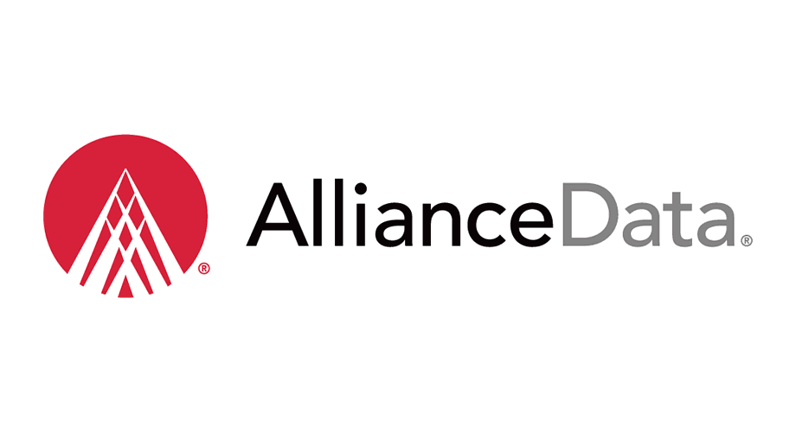
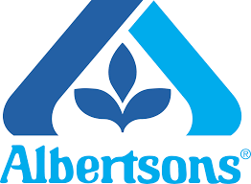
Portfolio Overview
SUMMARY
KEY TENANTS¹
$781 Million Total Assets Controlled¹
$617 Million Total Assets Owned²
23 Investments
5.7 Million Square Feet³
99.2% Occupancy⁴
9.56 Years Lease Duration⁵
63% Investment Grade⁶ (excluding multifamily)
56.8% Net Debt to Total Capitalization⁷
Apple Inc.
A Subsidiary of Amazon.com Inc.
As of December 31, 2021, except net debt to total capitalization which is as of September 30, 2021.
¹ Represents gross assets controlled by CF income Trust as reported in Supplement No. 12 dated January 18, 2022 and not adjusted for CF Income Trust’s current ownership percentage of any asset.
² Calculated as the total of all assets’ fair value used in determining our NAV.
³ Total Square footage is not adjusted for Cantor Fitzgerald Income Trust, Inc. (“CF Income Trust’s”) current ownership percentage. ⁴ Occupancy is weighted based on each asset’s fair value used in determining our NAV. For our industrial, retail and office investments, occupancy includes all leased square footage as of the date indicated. For our multifamily investments, occupancy is defined as the percentage of units leased on the date indicated. ⁵ Based on each asset’s fair value used in determining our NAV excluding multifamily, mezzanine and preferred equity investments.
⁶ Includes Daimler Trucks North America, LLC. Daimler AG, the parent company of Daimler Trucks North America, LLC, is rated A3 by Moody’s. Daimler AG does not guarantee the lease.
⁷ Net debt is as of September 30, 2021 and is calculated as loans payable less cash. Capitalization represents investments in real estate and real estate-related assets as of September 30, 2021.

Slide 23
Portfolio Composition
Diversified Across Property Types with a Strong Tenant Profile
PROPERTY TYPE
INVESTMENT TYPE
TENANT CREDIT PROFILE (Excludes Multifamily)
Necessity Retail
Life Sciences
Mezzanine Loan
Preferred Equity
Non-Investment Grade
Single Tenant Office
Unrated
Industrial
Investment Grade¹
Multifamily
Common Equity
Unless otherwise noted, calculated based on each asset’s fair value used in determining our NAV as of December 31, 2021.
¹ Includes Daimler Trucks North America, LLC. Daimler AG, the parent company of Daimler Trucks North America, LLC, is rated A3 by Moody’s. Daimler AG does not guarantee the lease.

Slide 24
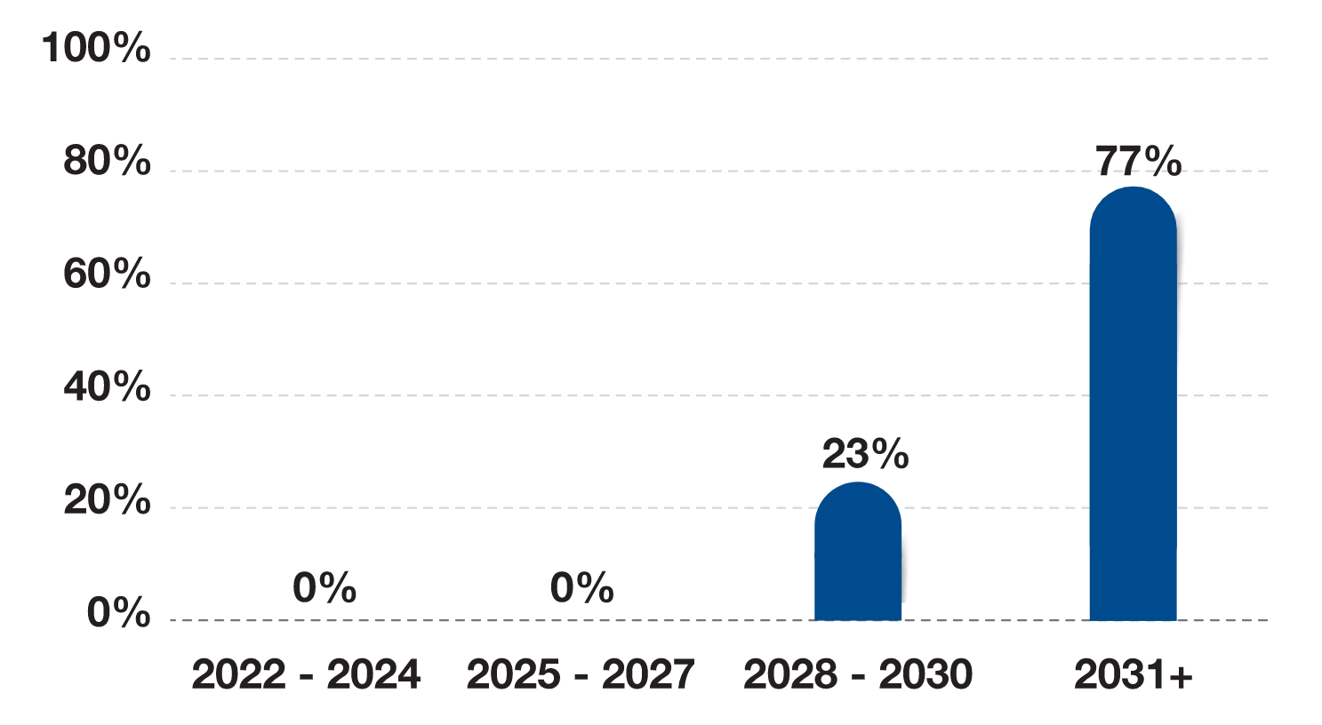
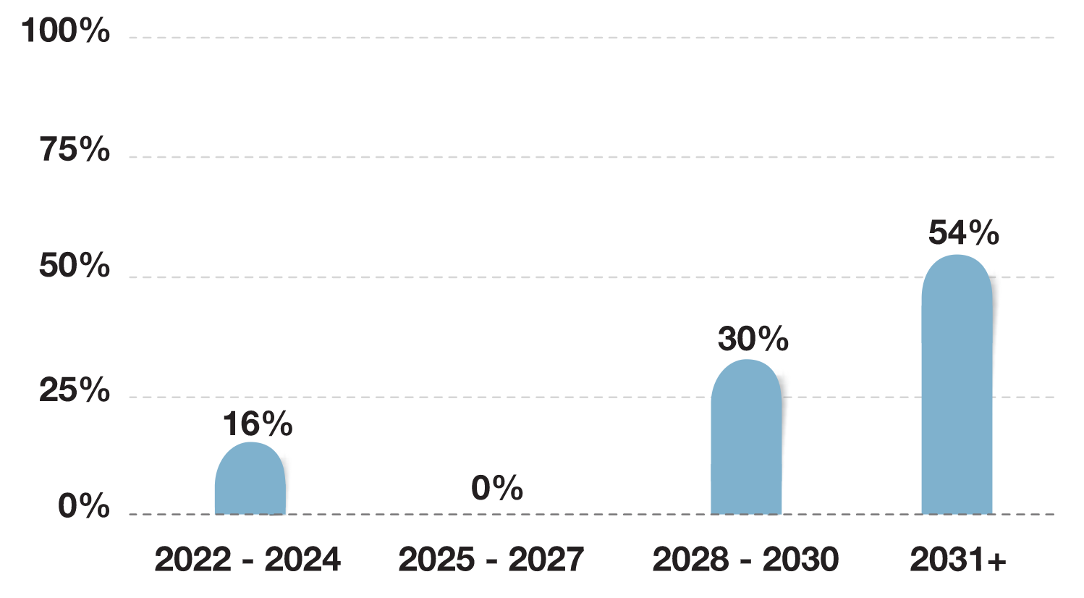
Portfolio Composition
lease Expirations¹
Lease duration³ 9.56 Years
Geographic breakdown¹
Percentage of Portfolio
0.01% - 5.0%
5.01% - 10.00%
10.01% - Above
debt maturities²
¹ Unless otherwise noted, calculated based on each asset’s fair value used in determining our NAV as of December 31, 2021.
² Calculated using principal balances as of December 31, 2021. Adjusted for CF Income Trust’s current ownership percentage of the underlying positions. ³ Based on each asset’s fair value used in determining our NAV excluding multifamily, mezzanine and preferred equity investments.

Slide 25
Performance As of December 31, 2021
NAV
NET Distribution AmountS¹
Returns²
Share Class | Net Asset Value | Amount Per Share / Per Month | Annualized Amount | Annualized Rate | Monthly | YTD | Annualized ITD³
Class I | $25.70 | $0.13 | $1.55 | 6.03% | 1.62% | 14.61% | 12.94%
Class D | $25.69 | $0.12 | $1.49 | 5.78% | 1.60% | 14.28% | 13.18%
Class S (with no sales load) | $25.68 | $0.11 | $1.33 | 5.19% | 1.55% | 13.61% | 12.44%
Class S (with sales load) | $25.68 | $0.11 | $1.33 | 5.19% | -1.89% | 9.77% | 9.40%
Class T (no sales load) | $25.68 | $0.11 | $1.33 | 5.19% | 1.55% | 13.61% | 12.01%
Class T (with sales load) | $25.68 | $0.11 | $1.33 | 5.19% | -1.89% | 9.77% | 9.32%
Class IX | $25.70 | $0.13 | $1.55 | 6.03% | 1.62% | 14.61% | 7.46%
Class AX (no sales load) | $25.70 | $0.13 | $1.55 | 6.03% | 1.62% | 14.61% | 7.46%
Class AX (with sales load) | $25.70 | $0.13 | $1.55 | 6.03% | -3.46% | 8.88% | 6.25%
Class TX (no sales load) | $25.68 | $0.11 | $1.29 | 5.04% | 1.53% | 13.49% | 6.39%
Class TX (with sales load) | $25.68 | $0.11 | $1.29 | 5.04% | -0.50% | 11.22% | 5.90%
CURRENT
ORIGINAL
¹ Annualized net distribution is based off the most recent declared distribution and assumes the daily rate derived from the most recently declared distribution per share per month is maintained for one year, less any applicable distribution fees. With respect to each share class, the rate shown is the annualized amount divided by the most recent available monthly net asset value. There is no guarantee of distributions. In the period from June 30, 2021 through September 30, 2021, 100% of distributions were funded from cash flows from operations.
² Returns shown reflect the percent change in the NAV per share from the beginning of the applicable period to the NAV as of December 31, 2021, plus the amount of any distribution per share declared in such period. All returns shown assume reinvestment of distributions pursuant to CF Income Trust’s distribution reinvestment plan, are derived from unaudited financial information and are net of all CF Income Trust’s expenses, including general and administrative expenses, transaction related expenses, management fees, any performance participation allocation, and share class specific fees, but exclude the impact of early repurchase deductions on the repurchase. Past performance is historical and not a guarantee of future results. Classes of shares listed as (With Sales Load) reflect the returns after the maximum up-front selling commission and dealer manager fees. Classes of shares listed as (No Sales Load) exclude up-front selling commissions and dealer manager fees. The returns have been prepared using unaudited data and valuations of the underlying investments in CF Income Trust’s portfolio, which are estimates of fair value and form the basis for CF Income Trust’s NAV. Valuations based upon unaudited reports from the underlying investments may be subject to later adjustments, may not correspond to realized value and may not accurately reflect the price at which assets could be liquidated. For more information on fees and expenses, please visit cfincometrust.com. ³ Annualized inception to date (“ITD”) returns are annualized using the Company’s NAV as of June 30, 2017 to December 31, 2021 with respect to the Class IX, Class AX and Class TX shares and using the Company’s NAV as of July 31, 2020 to December 31, 2021 with respect to Class I and Class T shares, and using the Company’s NAV as of September 30, 2020 to December 31, 2021 with respect to Class D and Class S shares.

Slide 26
Tax Efficiency
Tax Benefits of Real Estate and the REIT Structure
The Tax Cuts and Jobs Act of 2017 (TCJA) made significant changes to the federal income tax law including reduction of income tax rates for most individual tax brackets and the income tax rate for corporations.
Real estate under the TCJA, when owned in a REIT, provides shareholders a tax advantage not available to other income-producing investments since most of a REIT’s return is generated primarily from current distributions.
20% Qualified Business Income Deduction (QBID)
A REIT is considered a real estate “business” and qualified¹ REIT dividends are eligible for a 20% reduction in taxes owed. Under the TCJA, QBID drops the top effective income tax rate (not including the Medicare 3.8% tax) on qualified REIT dividends from 37%, the highest marginal income tax rate, to 29.6%, and that does not include the potential additional tax benefits from depreciation and return of capital.
Depreciation and Return of Capital
REITs and their shareholders also can benefit from property level depreciation. Depreciation allows a REIT to gradually write off the cost basis for its property, thereby reducing taxable income. Typically, only the building and improvements associated with a property are eligible for depreciation, not the land.
Combined, depreciation and the QBID can have a meaningful impact on the after-tax distributions generated from a REIT investment.
This sales and advertising literature does not constitute tax advice. Because each investor’s tax position is different, you should consult with your tax advisor. The Tax Cut and Jobs Act of 2017 is not applicable to capital gain dividends or certain qualified dividend income. It is only available for qualified REITs and the board is authorized to revoke the REIT election. The tax benefit expires on December 31, 2025. There may be adverse legislative or regulatory tax changes. Other investments may offer tax advantages. An accelerated depreciation schedule does not guarantee a profitable return on investment.
¹ REIT distributions are qualified if the investor has satisfied a 46-day REIT holding period requirements and they are not designated by the REIT as "capital gain dividends" or "qualified dividend income," both of which are taxed at the lower rate applicable to long-term capital gain. Short sale and other similar arrangements with respect to the REIT investment may also cause a REIT dividend to be not qualified.

Slide 27
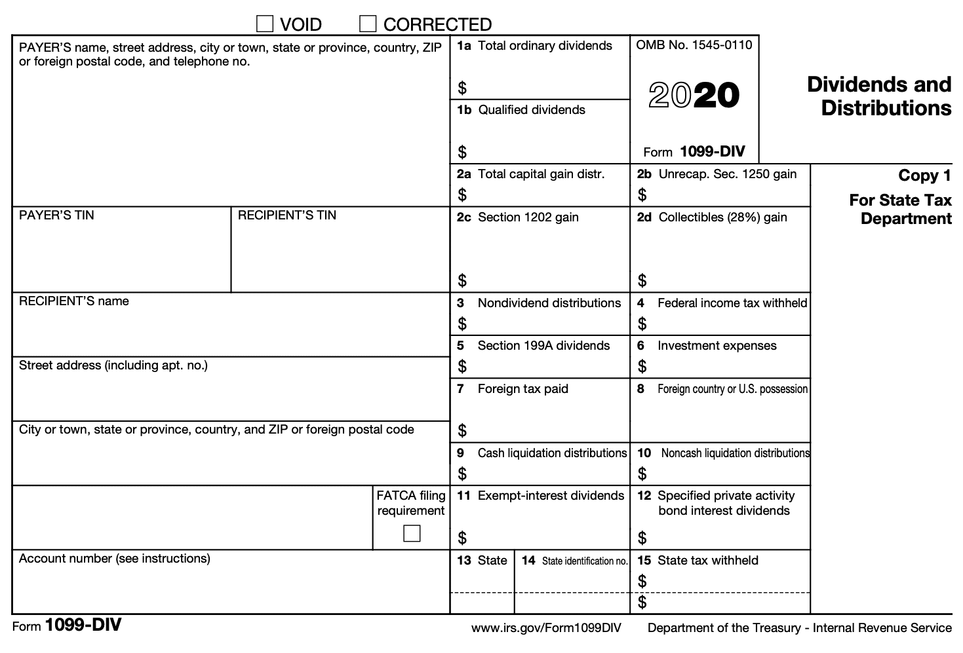
Sample 1099-DIV Tax Form
HYPOTHETICAL SCENARIO¹
$100,000 INVESTMENT (assuming an investor owned the IX share for all of 2020)
$100,000
Invested
$6,189
(6.19% Annual Distribution Rate)
37.88% Ordinary Income
Depreciation / Return of Capital
A portion of a REIT’s distributions may be considered a nontaxable return of capital. This not only reduces the shareholder's taxable income in the year the dividend is received but also defers taxes on that portion until the asset is sold for a gain.
Qualified Business Income Deduction
Under the TCJA, which expires on December 31, 2025, 20% of the $2,344 of “total ordinary dividends” would qualify as a deduction and effectively be tax free.
Key Takeaway
When lower tax rates are combined with a Return of Capital tax shelter, the effective federal tax rate for REITs may be reduced to approximately 19.0% based on the current illustration.
2,344
62.12% Return of Capital
3,844
This sales and advertising literature does not constitute tax advice. Because each investor’s tax position is different, you should consult with your tax advisor. The Tax Cut and Jobs Act of 2017 is not applicable to capital gain dividends or certain qualified dividend income. It is only available for qualified REITs and the board is authorized to revoke the REIT election. The tax benefit expires on December 31, 2025. There may be adverse legislative or regulatory tax changes. Other investments may offer tax advantages. An accelerated depreciation schedule does not guarantee a profitable return on investment.
¹Assuming the maximum ordinary tax bracket of 37%, the above scenario would result in an after-tax yield of approximately 5.5% and an effective federal tax rate of approximately 11.2%. If the tax bracket was 35%, the after-tax yield and effective federal tax rate would be approximately 5.5% and 10.6%, respectively. Under the TCJA, the effective tax rate is after the 20% reduction in rates introduced under the Tax Cuts and Job Act of 2017. Suitability standards may permit investors in lower brackets.

Slide 28
CFIT INVESTMENT STRATEGY
SECTOR REVIEW AND INVESTMENT HIGHLIGHTS

Slide 29
Sector Review – Net Lease
Net Lease Investments May Offer Increasing Cash Flows through
Various Economic Environments
Potential to mitigate volatility associated with market disruptions and economic recessions
Minimal on-going capital requirements with expenses borne by tenant
Typically escalating rents provide potential inflation hedge and generate growth in cash flow
%
Contractual Rent Growth
%
Year 7
%
Year 6
%
Year 5
%
Year 4
%
Year 3
%
Year 2
Year 1
No Property Level Expenses (NNN Lease)
Sources: PwC Real Estate Investor Survey, RCA; data as of March 31, 2020
An investment in Cantor Fitzgerald Income Trust is not a direct investment in real estate, and is subject to certain fees and expenses, as well as certain risks specifically applicable to an investment in non-traded REITs, which may adversely impact the value of the investment. For more information, please refer to the prospectus.

Slide 30
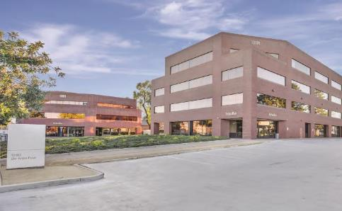
Investment Highlights – De Anza Plaza Apple Inc.
De Anza Plaza Apple Inc.
Cupertino, CA
PURCHASE PRICE
63,750,000
PROPERTY TYPE
Class A, Two Building Office Complex, Leasehold Interest
TENANT BUSINESS SECTOR
Technology
SQUARE FOOTAGE
30,406 (10001 Building) 53,553 (10101 Building)
YEAR COMPLETED
1985 and 1986
LEASE
Triple Net (NNN)
LEASE EXPIRATION
July 31, 2031
RENT ESCALATIONS
3.0% Annual Rent Escalations and Two Five-Year Renewal Options at 95% Fair Market Value
INVESTMENT HIGHLIGHTS
Well-Located in California’s Silicon Valley – The Property consists of 2 buildings on 1.84 acres and is located in the heart of Silicon Valley where office inventory is limited and in high demand.
Investment Grade Tenant – Apple Inc. (NASDAQ: APPL), the tenant under the lease, is an American multinational technology company that specializes in consumer electronics, computer software, and online services., and maintains an investment grade credit rating from S&P (‘AA+’) and Moody’s (‘Aa1’).
Long-Term Triple-Net Lease – Approximately 10 years with extension options and scheduled increases.

Slide 31
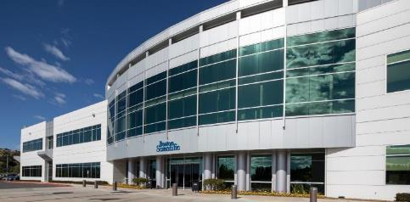
Investment Highlights – Boston Scientific Corporation
Boston Scientific Corporation
Santa Clarita (Valencia), CA (Los Angeles County)
PURCHASE PRICE
92,000,000¹
PROPERTY TYPE
Class-A Office Building
TENANT BUSINESS SECTOR
Life Sciences
SQUARE FOOTAGE
180,415 (Building), 40.5 Acres (Site), 528 (Parking Spaces)
YEAR COMPLETED
2006
LEASE
Triple Net (NNN)
LEASE EXPIRATION
December 31, 2035
INVESTMENT HIGHLIGHTS
High-Quality Headquarters Property - The property serves as the global headquarters for Boston Scientific’s Neuromodulation division, which develops implantable electronic technologies that help patients manage chronic pain and neurological conditions.
Investment Grade Tenant - Boston Scientific (NYSE: BSX), the tenant under the lease, is a leading life sciences company with a market capitalization of over $60.8 billion², and maintains an investment grade credit rating from S&P (‘BBB’), Moody’s (‘Baa2’) and Fitch (‘BBB’)³.
Well-Located in Greater Los Angeles Life Sciences Corridor - The property is located within the Southern California Innovation Park, which consists of 160 acres containing 15 buildings primarily leased to other life sciences tenants.
¹ Cantor Fitzgerald Income Trust, Inc. acquired, through a joint venture with its sponsor, beneficial interests representing 10% of the CF Valencia Life Sciences DST which owns the fee simple interest in the property..
² As of June 15, 2021
³ As of July 1, 2021

Slide 32
Investment Highlights – Daimler Trucks
Daimler Trucks North America
Regional Headquarters
FORT MILL, SC (CHARLOTTE MSA)
PURCHASE PRICE
$40 Million
PROPERTY TYPE
Class A Office
TENANT BUSINESS SECTOR
Automotive
SQUARE FOOTAGE
150,164
YEAR BUILT
February 2008
LEASE
Triple Net (NNN)
LEASE EXPIRATION 12/31/2028
RENT ESCALATIONS
2% Annually
INVESTMENT HIGHLIGHTS
Premier Tenant – Daimler Trucks is the world’s largest truck manufacturer.
Strategic Office Location - Regional headquarters located near five of the company’s manufacturing facilities.
Long-Term Triple-Net Lease with Annual Escalations
Exceptional Location – Strong office market within the growing Charlotte MSA.

Slide 33
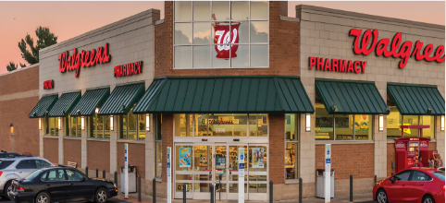
Investment Highlights – Walgreens
Walgreens
GRAND RAPIDS, MI
PURCHASE PRICE
$7.9 Million
PROPERTY TYPE
Single-Tenant, Freestanding Retail
TENANT BUSINESS SECTOR
Drug/Pharmacy
SQUARE FOOTAGE
14,552
YEAR BUILT
2007
LEASE
Triple Net (NNN)
LEASE EXPIRATION 7/31/2032
(With Twelve Five-Year Renewal Options)
INVESTMENT HIGHLIGHTS
Convenient Access – The property is well-positioned with convenient access and strong visibility on the corner of Alpine Ave. NW and 4 Mile Rd. NW. The property is less than 1.0 mile north of 1-96, providing convenient access from anywhere in the Grand Rapids metro area.
Desirable Retail and Commercial Corridor – Alpine Ave. serves as one of the premier retail corridors in Grand Rapids. Other major retailers in the immediate vicinity include Target, Walmart Supercenter and Home Depot.
Strong Market and Demographics – Grand Rapids is Michigan’s second-largest city, with a three-mile population of 48,331 and an annual household income of $57,116.

Slide 34
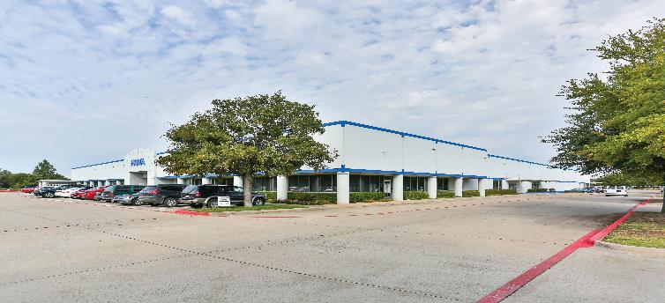
Investment Highlights – Hoya Optical Labs of America
Hoya Optical Labs of America
North American Headquarters
LEWISVILLE, TX
PURCHASE PRICE
$14.1 Million
PROPERTY TYPE
Flex Industrial
TENANT BUSINESS SECTOR
High-Tech and Health Care
SQUARE FOOTAGE
89,473
YEAR BUILT
1996
LEASE
Triple Net (NNN)
LEASE EXPIRATION 6/30/2028
(With Two Seven-Year Renewal Options)
INVESTMENT HIGHLIGHTS
Industry-Leading Tenancy - HOYA Optical Labs is one of the leading manufacturers of prescription lenses in North America. Clients include large corporate accounts, such as LensCrafters and Costco, and approximately 3,300 eye care professionals.
Premier Business Park Setting – The Property is located in the Waters Ridge Business Park, an institutional-quality industrial and office park comprised of more than 4.4 million square feet of rentable space.
Primary Market Location – The Dallas-Fort Worth industrial market is a regional distribution hub with strong fundamentals, including robust job and population growth.

Slide 35
Sector Review - Industrial
Logistics and E-Commerce Demand Creates Growth in Domestic Industrial Rents
E-Commerce Sales
E-Commerce Penetration
Source: Retail Indicators Branch, U.S. Census Bureau
Source: Newmark Knight Frank
An investment in Cantor Fitzgerald Income Trust is not a direct investment in real estate, and is subject to certain fees and expenses, as well as certain risks specifically applicable to an investment in non-traded REITs, which may adversely impact the value of the investment. For more information, please refer to the prospectus.

Slide 36
Investment Highlights – Amazon Last Mile
Amazon Last Mile
Distribution Facility
CLEVELAND, OH
PURCHASE PRICE
$30.8 Million*
PROPERTY TYPE
Industrial (Class A Last Mile Distribution Facility)
TENANT BUSINESS SECTOR
eCommerce Retailer
SQUARE FOOTAGE
168,750 (Building)
YEAR BUILT
2020
LEASE
Triple Net (NNN)
INVESTMENT HIGHLIGHTS
Investment Grade Guarantor – A subsidiary of Amazon.com Inc. “Amazon”), the guarantor under the lease, is a publicly traded company on the NASDAQ and is rated investment grade by Moody’s (‘A2) and S&P (‘AA-’).
Operationally Significant - The Property is built-to-suit for Amazon serving as one of two Amazon last mile distribution centers for the Cleveland area.
Strong Location - The Property is located within the Cleveland industrial submarket which benefits from close proximity to I-90, I-71, and I-490 providing access to Cleveland's primary transportation arteries and to a population of over 3.3 million people within a 50-mile radius.
*Cantor Fitzgerald Income Trust, Inc. acquired, through a joint venture, membership interests representing 9.9% and 90.1% in the Amazon Cleveland JV. Price shown is reflective of purchase price for the 100% of the asset.

Slide 37
Investment Highlights – Martin-Brower
Martin-Brower Cold Storage and Distribution Facility
PHOENIX, AZ
PURCHASE PRICE
$17.3 Million
PROPERTY TYPE
Industrial (Freezer, Cooler, Dry Storage)
TENANT BUSINESS SECTOR
Foodservice
SQUARE FOOTAGE
93,302
YEAR BUILT
1985 (Renovated/Expanded 2012)
LEASE
Triple Net (NNN)
LEASE EXPIRATION
6/20/2032
RENT ESCALATIONS
Approximately 5% Every Five Years
INVESTMENT HIGHLIGHTS
Global Distribution – Martin-Brower is one of the largest foodservice companies in the world and the largest distributor of food and supplies to McDonald’s restaurants worldwide.
Strategic Cold Storage Asset – The property serves as a key distribution point to the Southwestern U.S. and serves over 300 McDonald’s locations and over 100 Chipotle locations daily.
Long-Term Triple-Net Lease – Approximately 12 years of contracted cash flow with scheduled increases and virtually no landlord responsibilities.

Slide 38
Sector Review - Multifamily
Housing Affordability Driving U.S. Homeownership Down and the Number of Renters Up
S&P/Case-Shiller U.S. National Home Price Index, 2000=100
Real Median Household Income in the United States, 2000=100
Renter Households
Homeownership Rate
Sources: S&P Dow Jones Indices LLC and U.S. Census Bureau
Source: U.S. Census Bureau, Current Population Survey/Housing Vacancy Survey, June, 2020
An investment in Cantor Fitzgerald Income Trust is not a direct investment in real estate, and is subject to certain fees and expenses, as well as certain risks specifically applicable to an investment in non-traded REITs, which may adversely impact the value of the investment. For more information, please refer to the prospectus.

Slide 39
Investment Highlights – The Station at MacArthur
The Station at MacArthur Apartment Community
LAS COLINAS SUBMARKET
IRVING, TX (DALLAS-FORT WORTH MSA)
PURCHASE PRICE
$106 Million¹
PROPERTY TYPE
Class A Multifamily
YEAR BUILT
1994
NUMBER OF UNITS
444
AVERAGE UNIT SIZE
1,031
INVESTMENT HIGHLIGHTS
High-Quality Stabilized Asset – 304 units were fully renovated recently, 100% of the units include a direct-access garage, and 81% of the units offer a townhome floor plan.
Desirable Location within Strong Market – Dallas Fort Worth ranked as one of the top ten metros for employment and population growth over the past decade and is poised for continued growth.
Positive Rental Market Fundamentals – As of Q2 2020, the Dallas Fort Worth metro area had the highest demand for apartment units in the country.
Experienced Operator – Founded in 2010, CAF is a Dallas Fort Worth based real estate management firm which manages 50 properties (15,827 units) in Texas and 29 properties in the Dallas MSA.
*in select units
¹ Cantor Fitzgerald Income Trust, Inc. acquired, through its operating partnership, beneficial interests representing 15% of the Station DST which owns the fee simple interest in The Station at MacArthur. Price shown is reflective of purchase price for the 100% of the asset.

Slide 40
Investment Highlights – Keller Springs Crossing
Keller Springs Crossing
Multifamily Property
CARROLLTON, TX
PURCHASE PRICE
$56.5 Million*
PROPERTY TYPE
Multifamily
NUMBER OF UNITS
304
AVERAGE UNIT SIZE
841
Loan Amount
$31,277,000
Loan term
10 Year Interest Only
interest RATE
SOFR + 216 bps
INVESTMENT HIGHLIGHTS
Desirable Location – The Property is strategically located near Dallas North Tollway and President George Bush Turnpike, with easy access to DFW international Airport and major employment centers. Nearby downtown Carrollton offers commuters multiple light rail transit options with Dallas Area Rapid Transit (DART) and service to Denton using the Denton County Transportation Authority (DCTA). In addition, Keller Springs Crossing just 16 miles from downtown Dallas and minutes from world-class shopping and premier country clubs along with beautiful parks and wooded areas.
Experienced Operator – Founded in 2010, CAF is a Dallas Fort Worth based real estate management firm which manages 50 properties (15,827 units) in Texas and 29 properties in the Dallas MSA.
* Cantor Fitzgerald Income Trust, Inc. acquired, through its operating partnership, membership interests representing 78% of the Keller JV which owns the fee simple interest in the Keller Property. Price shown is reflective of purchase price for the 100% of the asset.

Slide 41
Sector Review – CRE Debt
Market Volatility has Created Attractive Investment Opportunities Across the Capital Stack
Both mortgage and mezzanine capital investments offer competitive risk-adjusted returns.
Mortgage: Loan secured by a lien on a commercial property
Senior Debt: Senior mortgage
B Note: Junior mortgage
Mezzanine Loan: Debt secured by the equity of the property-owning entity. Most junior form of debt that is senior to Equity. Debt and equity-like characteristics.
Preferred Equity: Senior to common equity and subordinate to debt investments. Often structured with debt-like features including a coupon and term.
COMMON EQUITY
EQUITY
PREFERRED EQUITY
MEZZANINE LOAN
MEZZANINE CAPITAL
80%
B NOTE
Loan to Value
SENIOR DEBT
60%
FIRST MORTGAGE

Slide 42
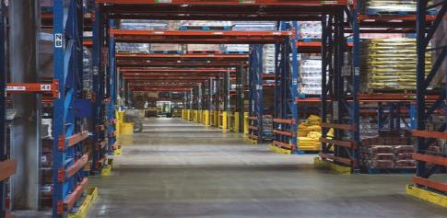
Investment Highlights – Albertsons Companies Inc. Portfolio
Albertsons Companies Inc.
Distribution Facilities
Melrose Park, IL
Denver, PA
PROPERTY TYPE
Industrial
(Freezer, Cooler, Dry Storage)
SIZE
1,561,613 SF
INVESTMENT TYPE
Mezzanine Loan
INVESTMENT AMOUNT
$12.6 Million
INTEREST RATE
7.75% - 8.74%
(Range from 2019-2028¹, increasing by 11 bps per year)
LOAN-TO-VALUE
75% of acquisition cost
PROPERTY TYPE
Industrial
(Freezer, Cooler, Dry Storage)
SIZE
1,539,407 SF
INVESTMENT TYPE
Preferred Equity
INVESTMENT AMOUNT
$11.8 Million
PREFERRED RETURN
7.75% - 8.74%
(Range from 2019-2028¹, increasing by 11 bps per year)
ATTACHMENT POINT
75% of acquisition cost
INVESTMENT HIGHLIGHTS
Industry Leading Tenancy –100% leased to a subsidiary of Albertsons Companies Inc. (“Albertsons”), with a parent guaranty from the third largest supermarket chain in North America with $62.5 billion in sales and other revenue².
Returns – Favorable risk adjusted return given basis in assets.
Long-Term Leases – New 20-year net leases with annual rent escalations.
Experienced Sponsor – U.S. Realty Advisors, the owner of the Properties, specializes in net lease real estate investments with over $2.3 billion under management.
¹ The preferred return and interest rate shown apply only to the above investments and do not reflect the return or distribution of Cantor Fitzgerald Income Trust. The properties shown represent investments in the portfolio among other portfolio assets. Other portfolio assets will have different terms and returns or rates.
² As of fiscal year 2019 ended February 29, 2020.

Slide 43
Offering Details
Strategy | We intend to invest primarily in stabilized, income-producing commercial real estate primarily located in the U.S.
Structure | Publicly registered, non-traded, perpetual life NAV REIT
Portfolio Allocation | We will seek to invest: (a) at least 80% of our assets in properties and real estate-related debt; and (b) up to 20% of our assets in real estate-related securities
Sponsor / Advisor | Cantor Fitzgerald Investors, LLC / Cantor Fitzgerald Income Trust Advisors, LLC
Maximum Offering Size | $1.25 Billion
Offering Price¹ | Generally equal to our prior month's NAV per share for such class as of the last calendar day of such month, plus applicable selling commissions and dealer manager fees
Minimum Investment | $2,500 in Class D, Class S and Class T Shares / $1,000,000 in Class I Shares
Distribution Frequency² | Monthly – Subject to board declaration
Distribution Reinvestment Plan (DRP) | Up to $250 million (Monthly, shares purchased at NAV
Suitability Requirements | $250,000 net worth or $70,000 net worth and $70,000 annual gross income Higher suitability in certain states; please consult the prospectus
Tax Reporting | Form 1099-DIV
Share Repurchase Plan³ (as a percentage of NAV, pro-rata redemptions, monthly availability) | Monthly repurchases will be made at the transaction price, which is generally equal to our prior month’s NAV Shares not held for at least one year will be repurchased at 95% of that month’s transaction price Overall limit of 2% of NAV per month and 5% of NAV per calendar quarter Shares redeemed at transaction price in case of death or qualifying disability
¹ We may offer shares at a price that we believe reflects the NAV per share of such stock more appropriately than the prior month’s NAV per share, including by updating a previously disclosed offering price, in cases where we believe there has been a material change (positive or negative) to our NAV per share since the end of the prior month.
² There is no guarantee of distributions. Distributions have and may continue to be paid from other sources other than cash flow from operations, including offering proceeds, which reduce investor’s overall return. Distributions paid with respect to Class D Shares, T Shares and Class S Shares will be reduced by the ongoing distribution fee payable with respect to such classes of shares.
³ Repurchases are limited to 5% per quarter and 2% per month of the combined NAV of all classes of shares as of the last calendar day of the previous calendar quarter or month, respectively; the program may be modified, suspended or terminated at any time upon ten days prior written notice to stockholders.
Available for electronic subscription via Altigo

Slide 44
Multiple Share Classes
SHARE CLASS-SPECIFIC FEES | Class I | Class D | Class S | Class T
Availability¹ | Advisory, Institutional and Fiduciary Accounts |  | Brokerage Accounts
Offering Price | 100% | 100% | 100% | 100%
Upfront Selling Commissions^{2, 3} | (0.00%) | (0.00%) | (3.50%) | (3.00%)
Upfront Dealer Manager Fee^{2, 3} | (0.00%) | (0.00%) | (0.00%) | (0.50%)
Initial Account Value | 100% | 100% | 96.62% | 96.62%
Ongoing Distribution Fee² (per annum, payable monthly) | 0.00% | 0.25% | 0.85% | 0.65% Advisor 0.20% Dealer
ADVISOR FEES
Management Fees | 1.20% per annum of NAV, payable monthly
Performance Participation | 12.5% of the annual total return, subject to a 5% annual hurdle amount, a high-water mark and catch-up
No Acquisition⁴ or Financing Fees
¹ Select broker-dealers may have different suitability standards, may not offer all share classes, and/or may offer CF Income Trust at a higher minimum initial investment.
² We will cease paying the stockholder servicing fee with respect to any shares held in a stockholder’s account at the end of the month in which the dealer manager in conjunction with the transfer agent determines that total upfront selling commissions, dealer manager fees and stockholder servicing fees paid with respect to such shares would exceed 8.75% (or, in the case of Class T shares sold through certain participating broker-dealers, a lower limit as set forth in any applicable agreement between the dealer manager and a participating broker-dealer at the time such Class T shares were issued) of the gross proceeds from the sale of such shares (including the gross proceeds of any shares issued under our distribution reinvestment plan with respect thereto).
³ Calculated as a percentage of transaction price.
⁴ Cantor Fitzgerald Income Trust will also incur customary acquisition expenses in connection with the acquisition and/or origination of its investments. Actual amounts will be dependent upon actual expenses incurred and, therefore, cannot be determined at this time.

Slide 45
FINANCIAL PROFESSIONALS INQUIRIES:
Cantor Fitzgerald & Co.
110 E. 59th St.
New York, NY 10022
1-855-9-CANTOR (22-6867) cfsupport@cantor.com
cfincometrust.com
INVESTORS:
If you are interested in investing in Cantor Fitzgerald Income Trust, please contact your financial advisor or visit www.cfincometrust.com
ALL OTHER INQUIRIES
Cantor Fitzgerald Income Trust, Inc.
110 E. 59th St.
New York, NY 10022
1-855-9-CANTOR (22-6867)
Securities distributed by Cantor Fitzgerald and Co.
Cantor Fitzgerald Capital is a division of Cantor Fitzgerald & Co. (Member FINRA/SIPC), the Dealer Manager for the offerings discussed herein.
CANTOR FITZGERALD INCOME TRUST, INC.

